Slide 1
VEHICLE ACCIDENT DETECTION SYSTEM USING ARDUINO
Submitted by: B. Aswin

Slide 2
ABSTRACT
The medicine reminder app is a mobile application designed to help individuals keep track of their medication schedules.
The app is equipped with a user-friendly interface that allows users to input their medication regimen and set reminders for when to take their medication.
The app can be highly beneficial for individuals with chronic illnesses, elderly individuals, and people with complex medication regimes

Slide 3
INTRODUCTION
In today's busy world, we often forget to take our medications at the right time.
This can lead to serious health problems, especially for individuals with chronic illnesses.
To address this issue, we propose a Medicine Reminder Application that will help individuals keep track of their medication schedule.
The World Health Organization (WHO) defines chronic illness as a long-term condition that can be managed, but not cured.
Living with a chronic illness can be very challenging, both physically and emotionally.

Slide 4
PROJECT OVERVIEW
The purpose of this project is to develop a medicine reminder application that helps users manage their medication schedule and stay on track with their prescriptions.

Slide 5
OBJECTIVE OF THIS PROJECT
The objective of a medicine reminder application is to help users manage their medication schedules effectively and improve medication adherence.

Slide 6
LITERATURE SURVEY

Slide 7
SYSTEM REQUIREMENTS

Slide 8
HARDWARE REQUIREMENTS
64-bit Microsoft® Windows® 8/10.
x86_64 CPU architecture; 2nd generation Intel Core or newer, or AMD CPU with support for a Windows Hypervisor.Framework.
8 GB RAM or more.
8 GB of available disk space minimum (Flutter + Android Emulator)
1280 x 800 minimum screen resolution.

Slide 9
SOFTWARE REQUIREMENTS
Front End: Flutter (Flutter 3.3.0 and above)
OS: Android / IOS

Slide 10
SYSTEM ANALYSIS

Slide 11
EXISTING SYSTEM
There are many solutions proposed for the concerned problem and each one have some advantage over others.
These applications offer a range of features and functionalities, including medication schedules, reminders, refill alerts, and prescription tracking.

Slide 12
DISADVANTAGES OF EXISTING SYSTEMS
Privacy Issues
Not responding Properly

Slide 13
PROPOSED SYSTEM
The proposed system is a medicine reminder application designed to help individuals keep track of their medication schedules.
The main objective of the medicine reminder application is to help users manage their medication schedules effectively, so they do not miss a dose or take the wrong medication at the wrong time.
The system will provide users with reminders to take their medication in correct timing.

Slide 14
ADVANTAGES OF THE PROPOSED SYSTEM
The users will get the notifications through SMS.
Reduces medication errors.
Improves medication adherence.

Slide 15
SYSTEM DESIGN

Slide 16
SYSTEM ARCHITECTURE

Slide 17
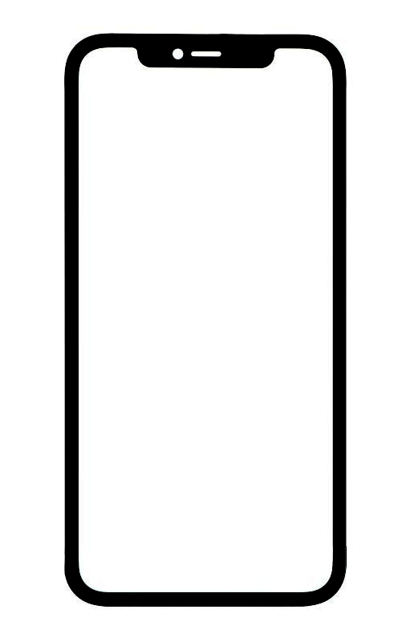
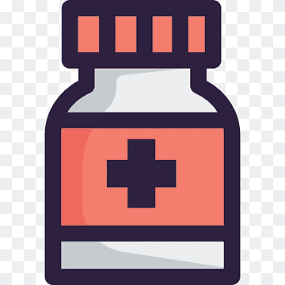



Add Medicine
Medicine
Alert Notification
Set Reminder
ALERT
Reminder
Patient
Fig.5.1. Architecture of the Proposed System

Slide 18
Step 1: The user sets up their medication schedule by adding medication name, dosage, frequency, and time of day they need to take their medication.
Step 2: The application stores the medication schedule in the database.
Step 3: The application checks the current time against the medication schedule to determine if it's time to trigger a reminder.
Step 4: If it's time for a medication reminder, the application displays a notification to the user with the medication name, dosage, and any other relevant details.
Step 5: The user can then acknowledge the notification by marking the medication as taken or snooze the reminder to be reminded later.

Slide 19
Step 6: If the user marks the medication as taken, the application updates the medication schedule in the database to reflect that the medication has been taken.
Step 7: If the user snoozes the reminder, the application reschedules the reminder to a later time, based on the user's preference.

Slide 20
BLOCK DIAGRAM

Slide 21
User Interface
(App UI)
Input Logic
Database Logic

Slide 22
Reminder Logic
Notification
User Action

Slide 23
User Interface (App UI): This block includes the screens and controls that the user interacts with to input medication details and schedule reminders.
Input Logic: This block handles user input validation and formatting before passing it on to the next block.
Database Logic: This block stores medication and reminder details in a database and retrieves them when needed.
Reminder Logic: This block checks the medication schedule and sends notifications to the user when it's time to take their medication.

Slide 24
Notification: This block sends push notifications or alerts to the user's device.
User Action: This block is triggered when the user receives a notification and takes action to mark the medication as taken or snooze the reminder for later.

Slide 25
FLOW DIAGRAM

Slide 26
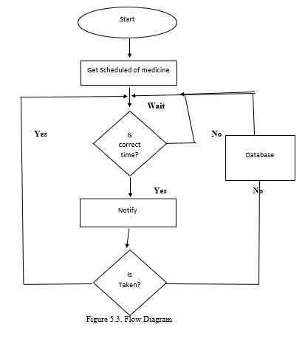

Slide 27
CHAPTER 6
SYSTEM MODULE

Slide 28
Module for the Proposed System
The project consists of two modules. They are
Home page Module
Calendar page Module
Mobile notification module

Slide 29
6.1.1 Home Page Module
The top of the screen should have a title, such as "My Medications" or "Medication Reminders."
Below the title, there should be a button or icon to add a new medication. This should be easily visible and accessible.
The main body of the screen should display a list of medications that the user has already added. Each medication should be displayed with its name, dosage, and time(s) of day that it needs to be taken.
For each medication, there should be a button or icon to edit or delete it.
At the bottom of the screen, there should be a button to view the "Calendar" page.

Slide 30
6.1.2 Calendar page Module
The top of the screen should have a title, such as "My Medication Calendar."
Below the title, there should be a calendar view with the current date highlighted.
Each day on the calendar should show the medication(s) that need to be taken on that day, with their names and times.
When the user taps on a day, a modal should appear that displays more details about the medication(s) for that day.
At the bottom of the screen, there should be a button to return to the "Home" page.

Slide 31
6.1.3 Mobile Notification Module
A medicine reminder notification module is a software tool that can be used to set reminders for taking medications. It can be programmed to send notifications to the user at specific times or intervals, reminding them to take their medication as prescribed.
The module can be integrated into various platforms such as mobile applications, smartwatches, and desktop applications. Users can input their medication schedule and dosage information into the module, and it will generate notifications at the appropriate times.
The module can also be used to keep track of the user's medication history, such as when they took their medication and how much they took. This information can be useful for healthcare providers to monitor their patients' adherence to medication regimens.

Slide 32
CHAPTER 8 CONCLUSION AND FUTURE ENHANCEMENT
The medicine reminder application is an essential tool for people who need to take medication regularly. It provides an efficient and convenient way for users to manage their medication schedule, ensuring that they do not miss any doses. The application is user-friendly and easy to use, making it suitable for people of all ages. With the use of technology, medicine reminder applications have made it easier for people to take their medication on time and avoid any complications that may arise from missed doses.

Slide 33
There are several Future enhancements that can be made to the medicine reminder application to make it more useful and efficient. Some of these enhancements include:
Integration with wearable technology: The application can be integrated with wearable technology such as smartwatches and fitness bands. This integration would enable the application to send notifications to the user's wearable device, ensuring that they do not miss any doses.
Integration with pharmacy services: The application can be integrated with pharmacy services to enable automatic refills and deliveries of medications. This feature would eliminate the need for the user to manually refill their prescriptions.

